Slide 1

Automatic Text Summarization
Group 5
final results

Slide 2
Content
Situation
Task
Action
Result

Slide 3
Situation

Slide 4
multi document summarazation
Situation
Task
Action
Result
sth about related work and whats going on in multi document summarization

Slide 5
Task

Slide 6
hierarchical approach
Situation
Task
Action
Result
desctiption of the task with the hierarchical model and the

Slide 7
Action

Slide 8
Step 1
Situation
Task
Action
Result
finding nuggets

Slide 9
Step 2
Situation
Task
Action
Result
sorting nuggets

Slide 10
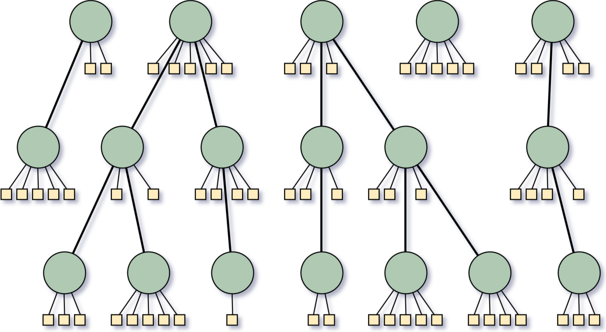
Step 3 – Creating summaries from hierarchies
Situation
Task
Action
Result

Slide 11
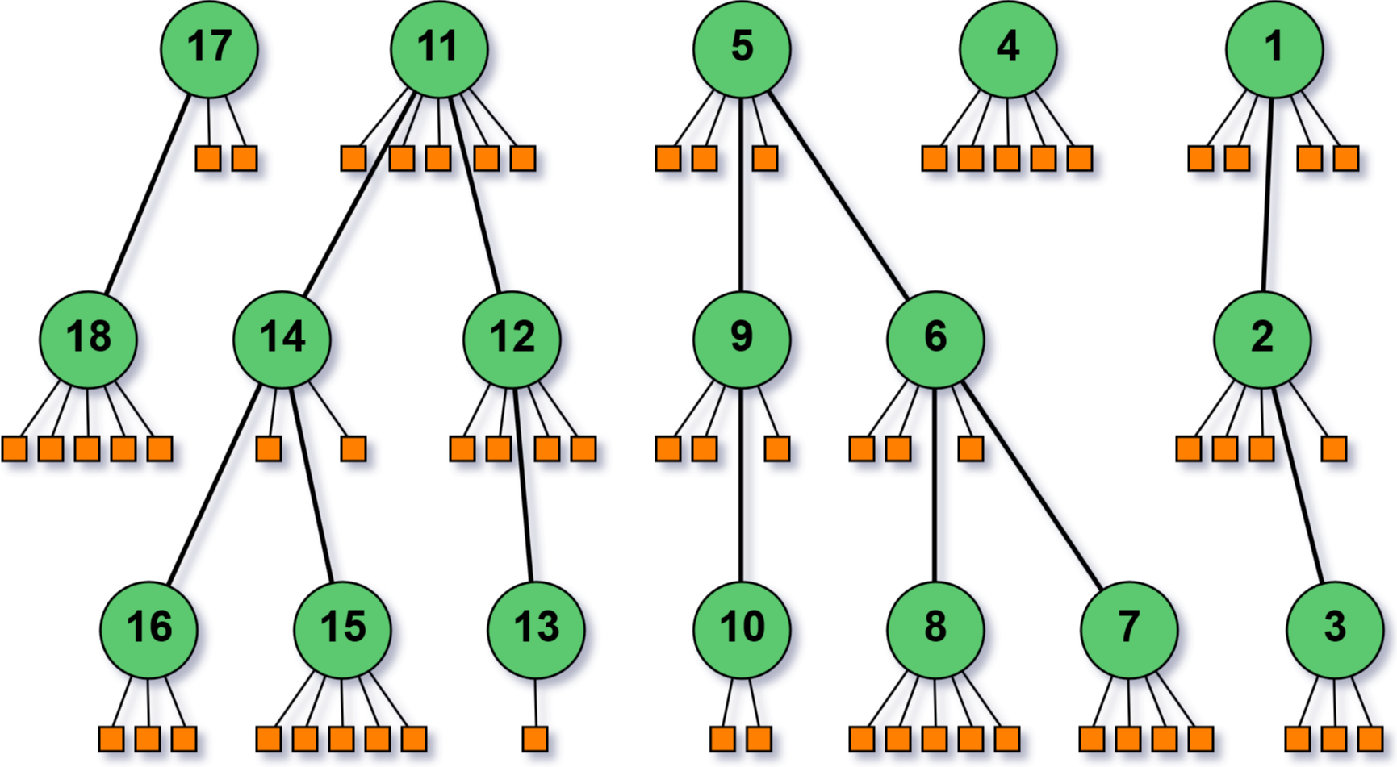
Step 3 – Creating summaries from hierarchies
Situation
Task
Action
Result
first approach: Iterate in depth-first search order over the nuggets

Slide 12
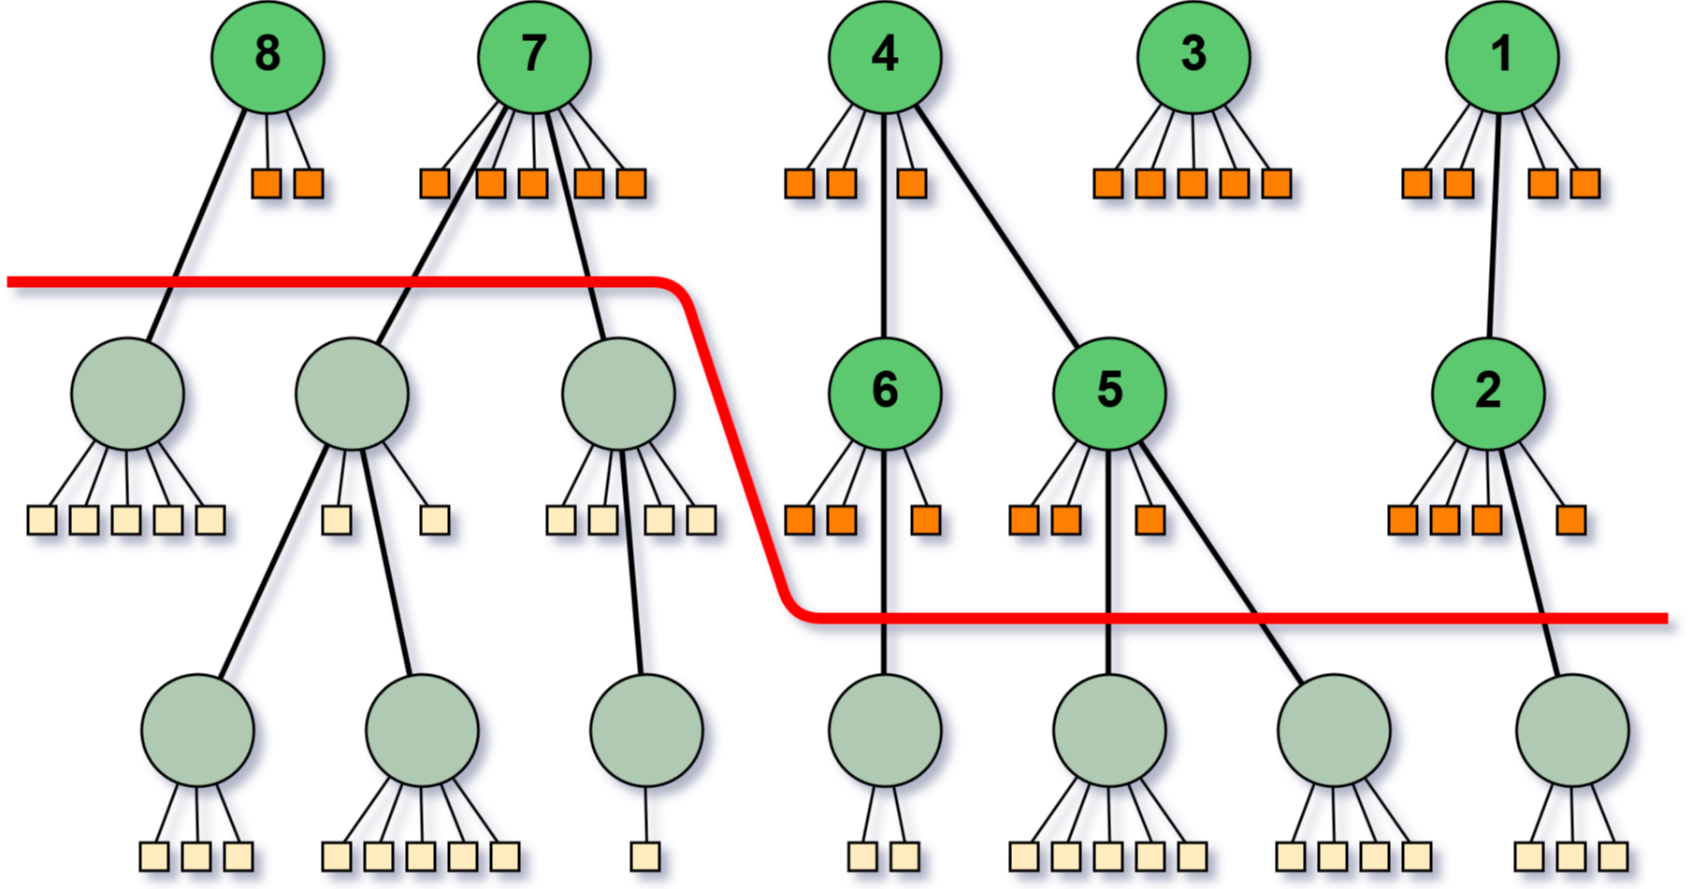
Step 3 – Creating summaries from hierarchies
Situation
Task
Action
Result
cut layers off to get shorter summaries

Slide 13
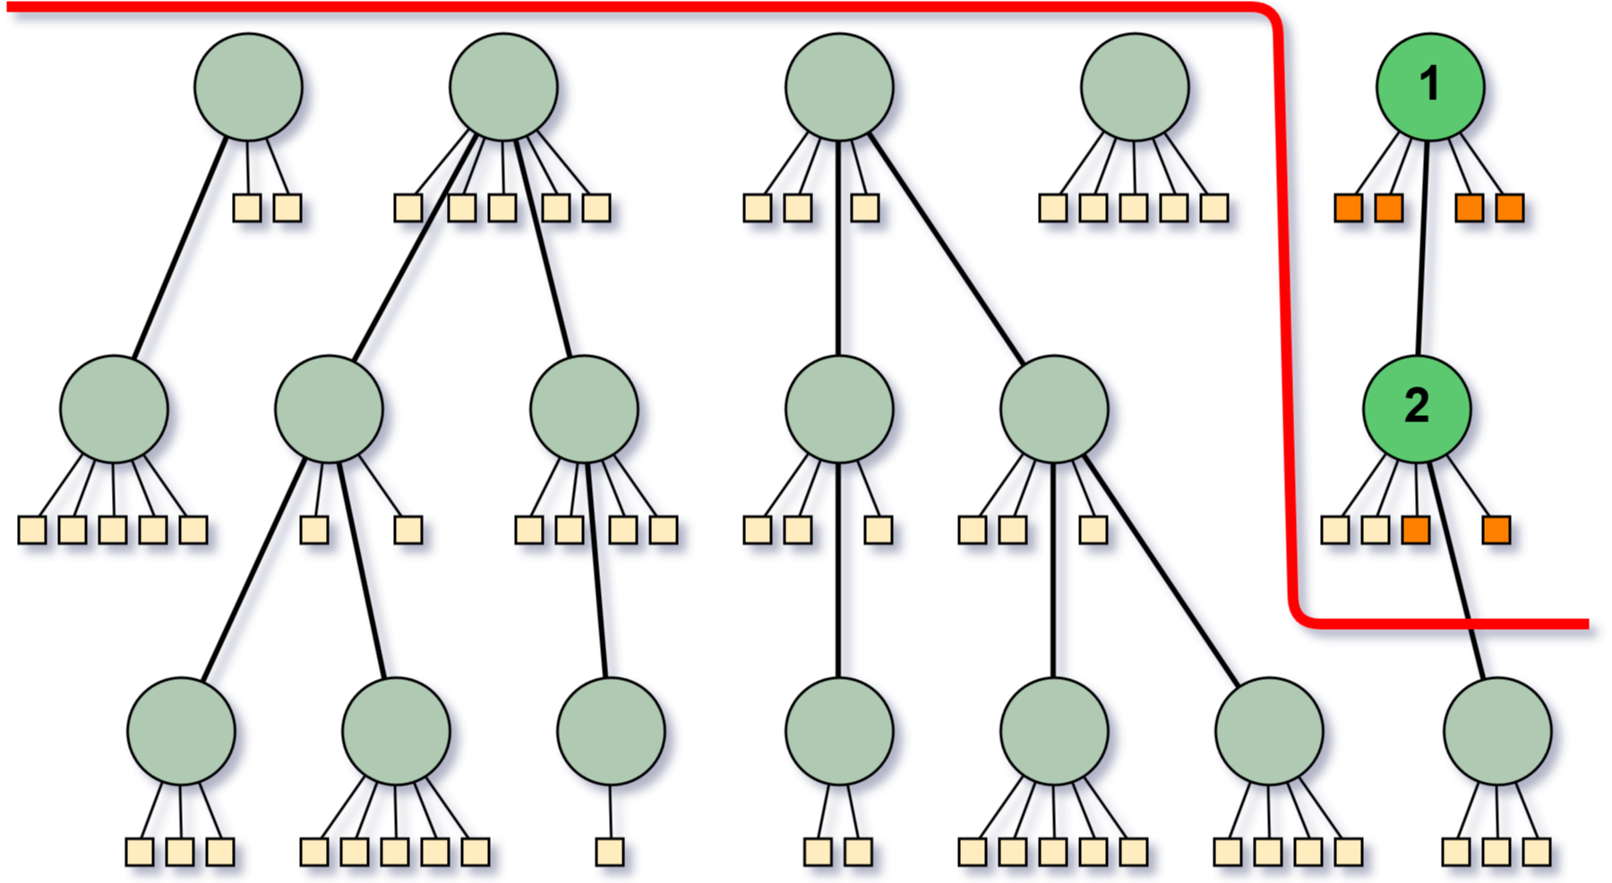
Step 3 – Creating summaries from hierarchies
Situation
Task
Action
Result
problem when summaries are very short

Slide 14
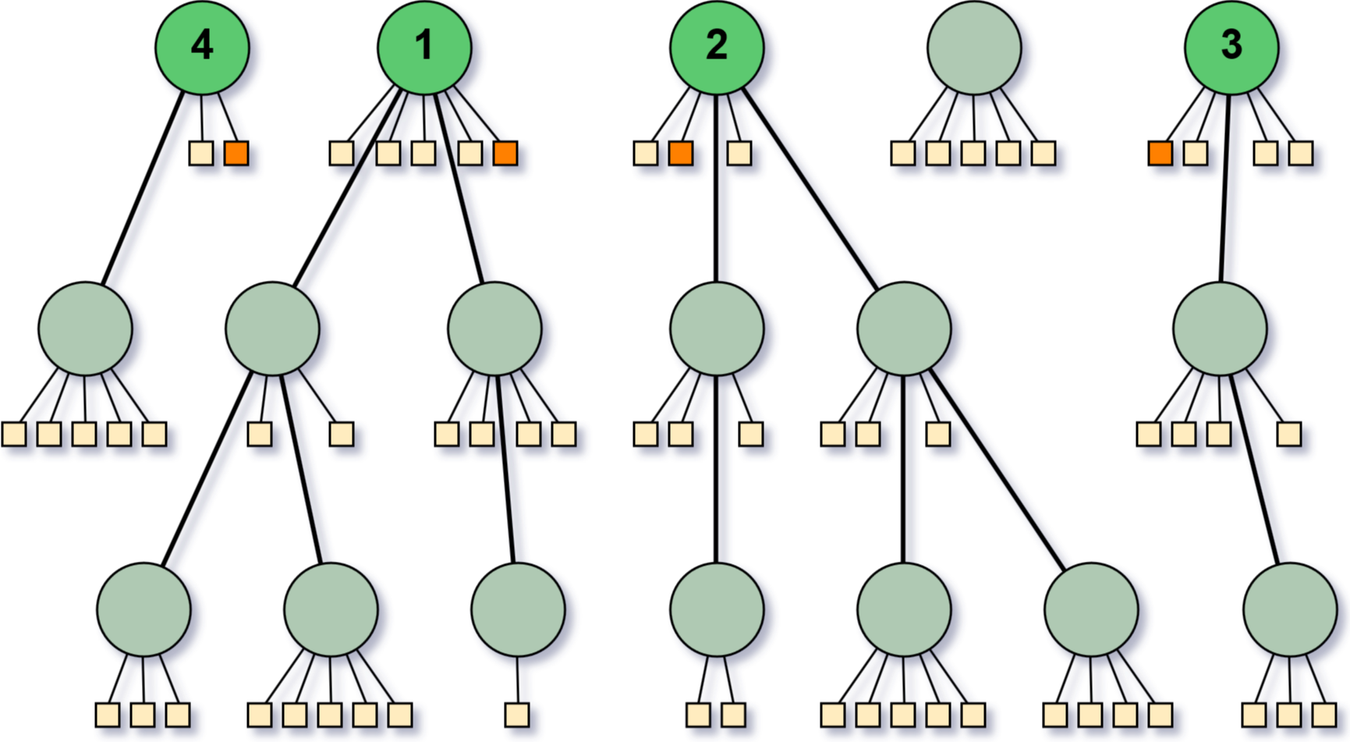
Step 3 – Creating summaries from hierarchies
Situation
Task
Action
Result
select shortest sentences from root bubbles of the largest trees

Slide 15
Step 3 – Creating summaries from hierarchies
Situation
Task
Action
Result

Slide 16
Result

Slide 17
evaluation
Situation
Task
Action
Result
each of our summaries were evaluated by at least 4 raters

Slide 18
Thank You for your attention

